Slide 1
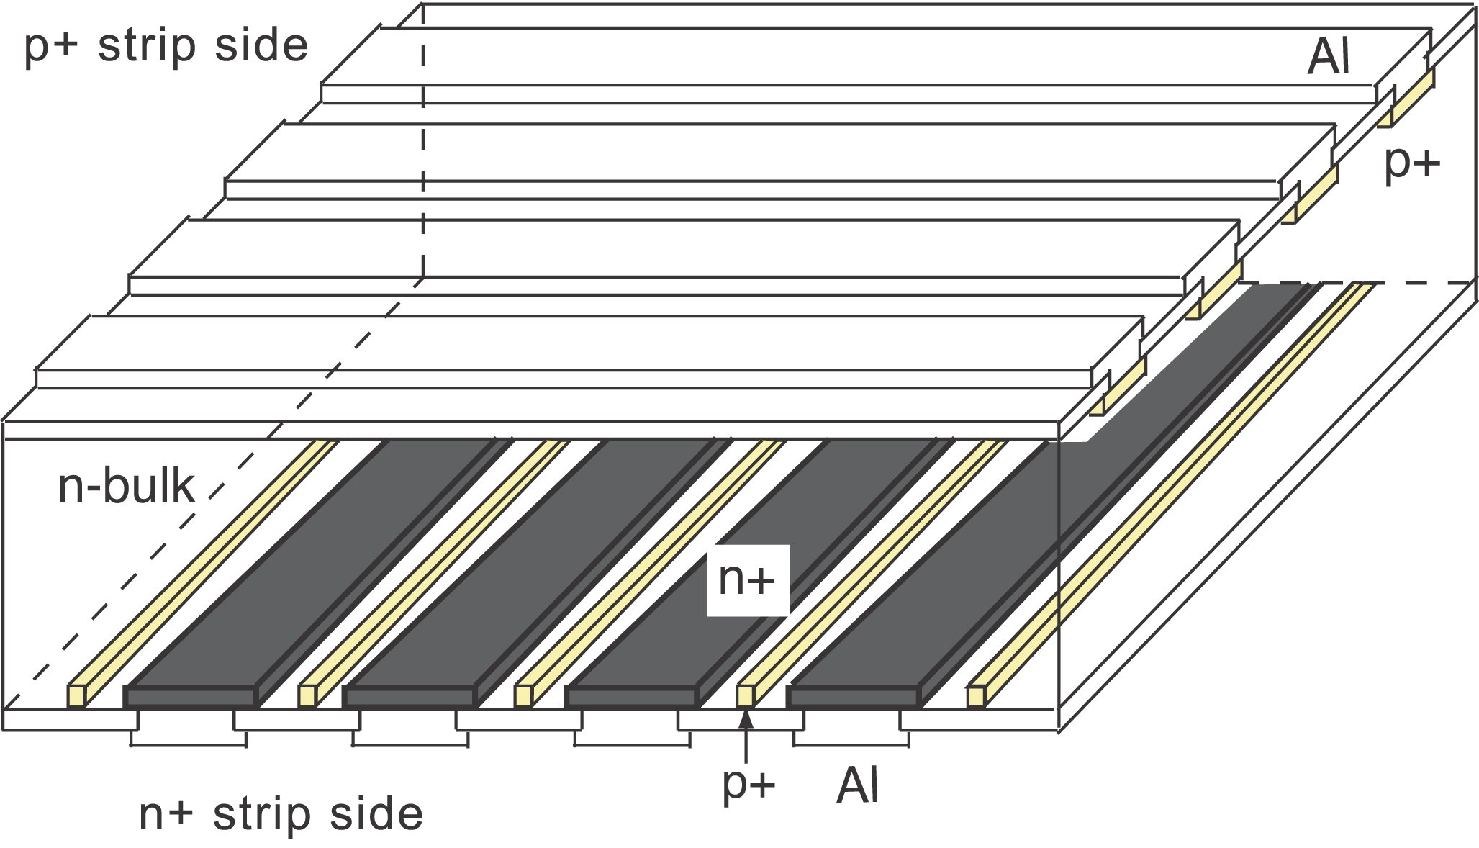
ionizing particle
p⁺
h
e⁻
e⁻
h
V
e⁻
h
n⁺

Slide 4
L = 140 mm
A
B
x
L - x

Slide 5
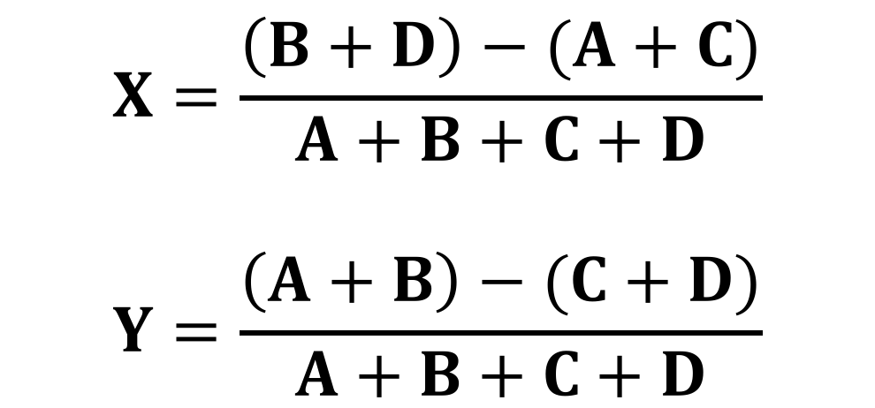
y
A
x
30 mm
B
C
D
35 mm
$$X=\frac{\left(B+D\right)−(A+C)}{A+B+C+D}$$
$$Y=\frac{\left(A+B\right)−(C+D)}{A+B+C+D}$$
38 mm

Slide 7
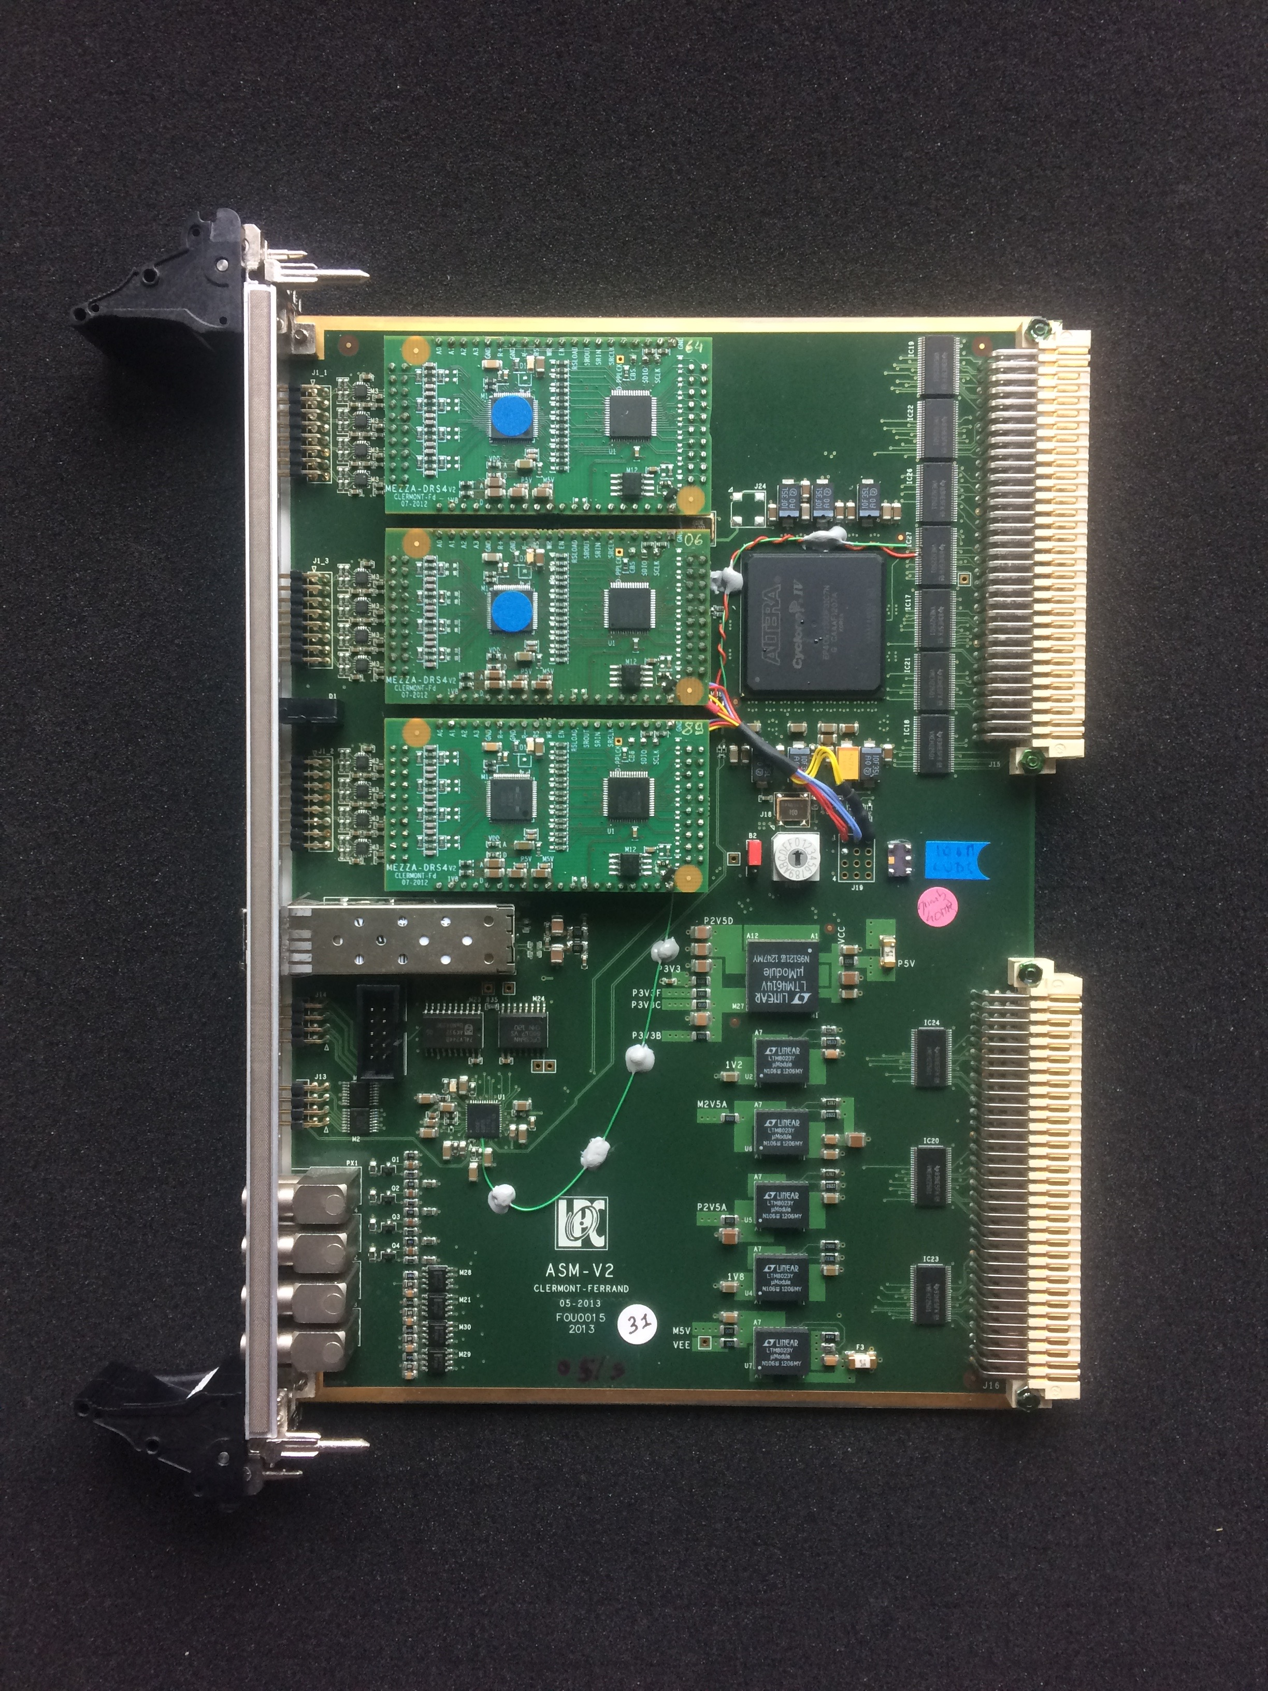
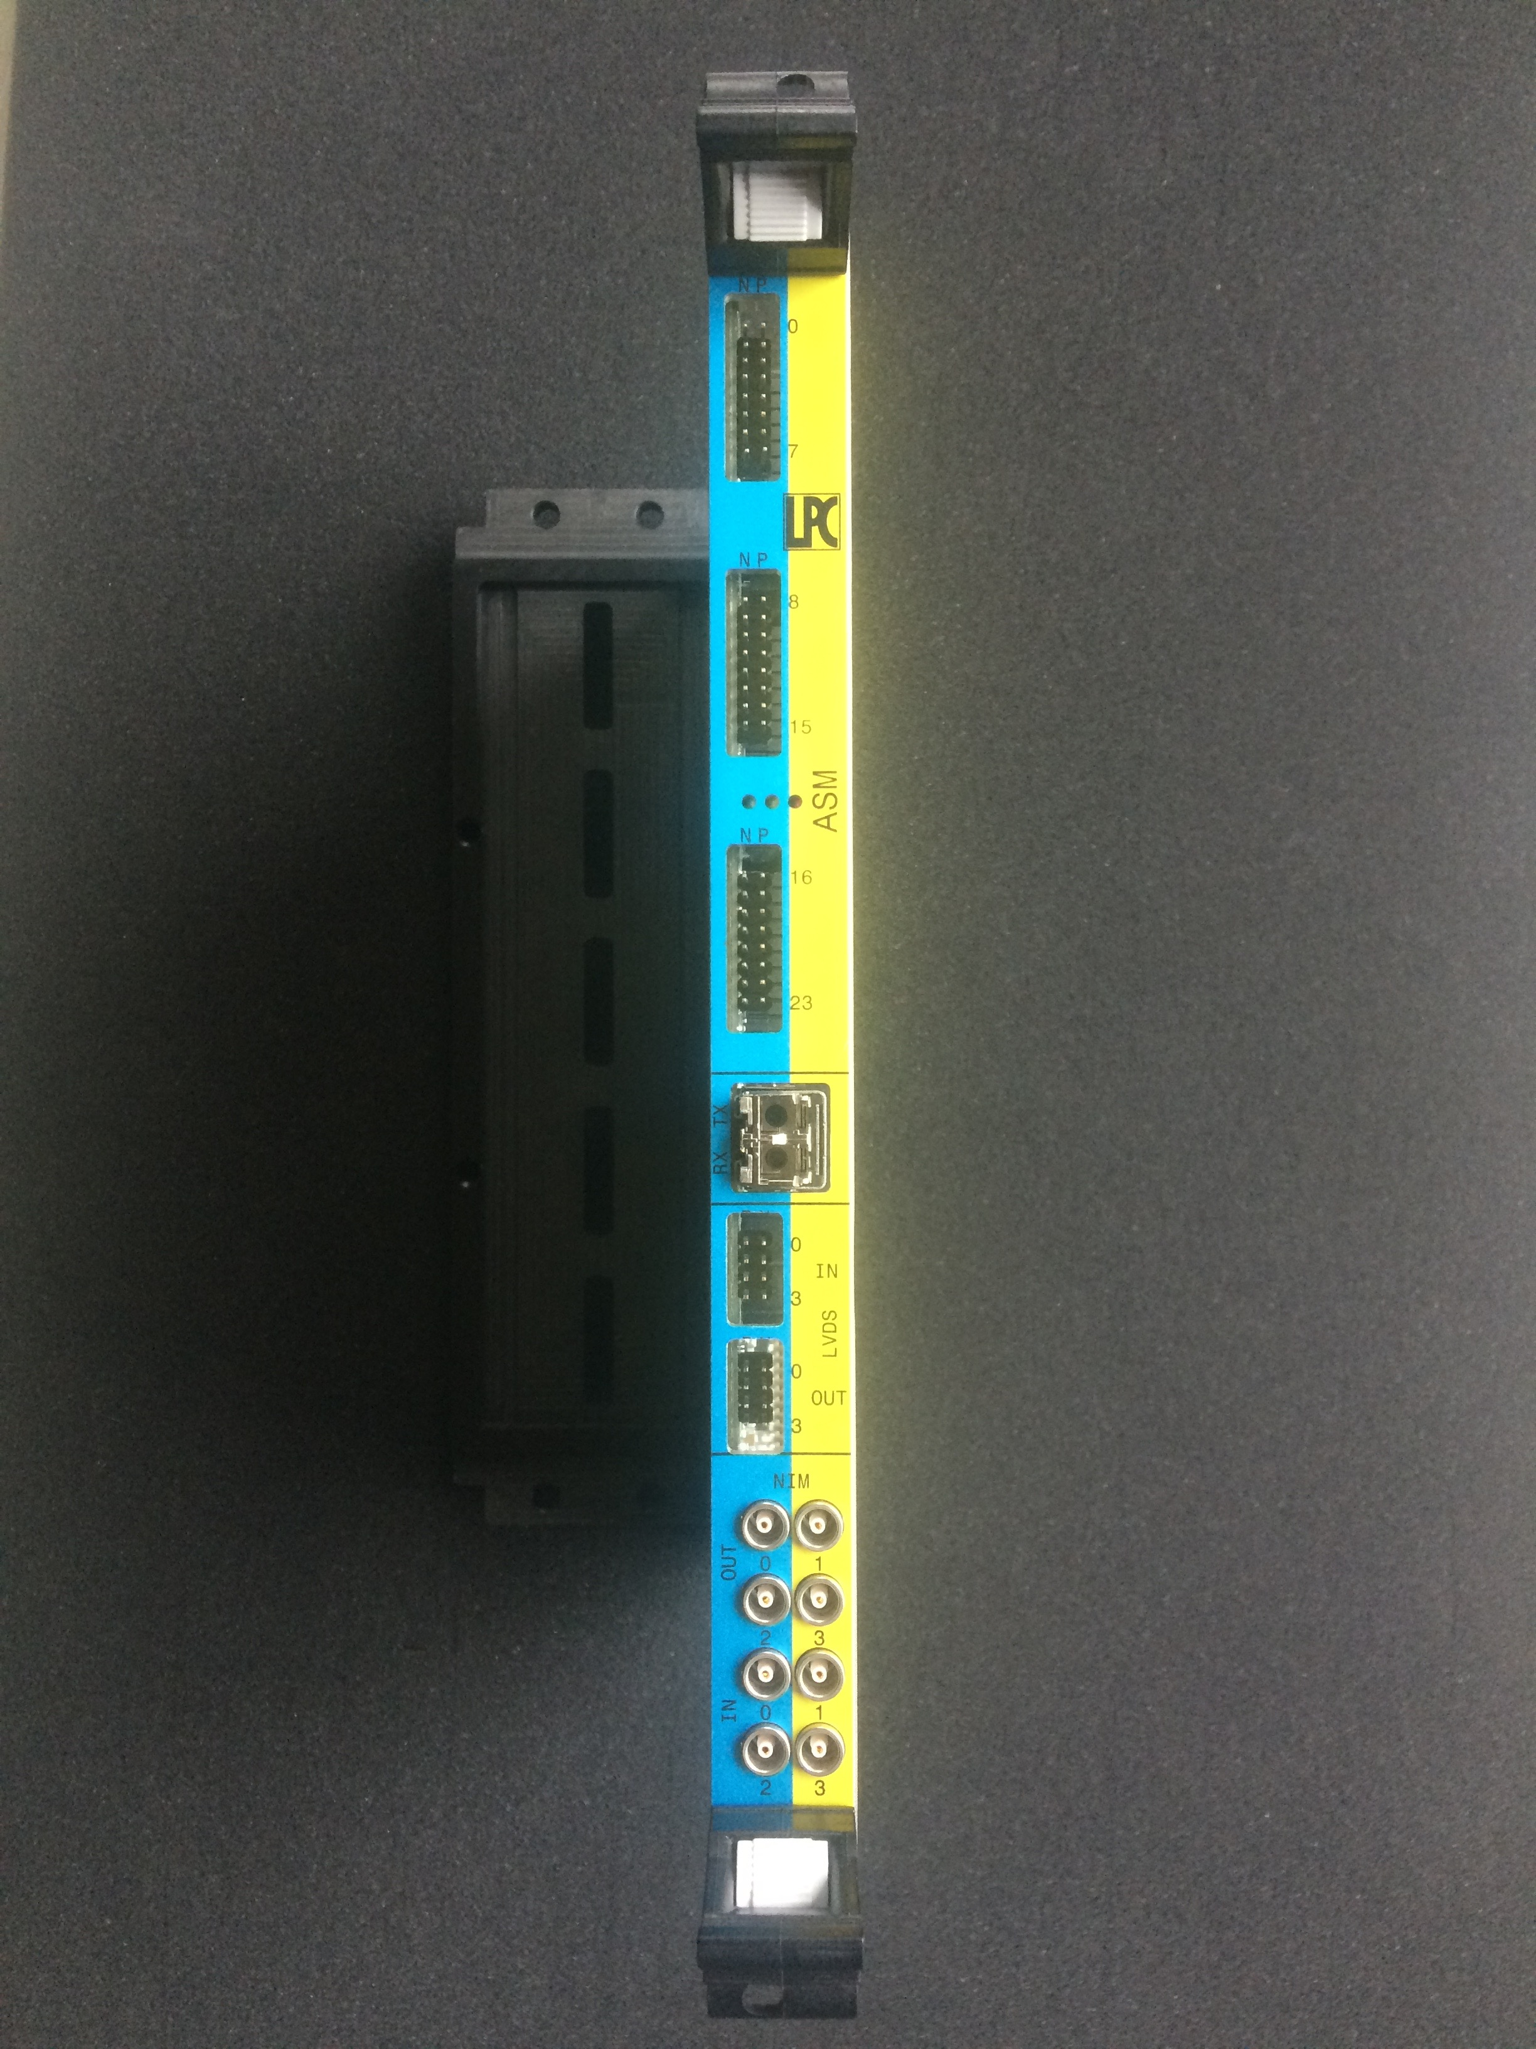

Slide 8
